Slide 1
Analysis of the cycles distribution in connected networks
by Artem Vergazov

Slide 2
Problems
Literature study on Erdős-Renyi random graphs in the context of rings formation
Analytical expression for number and distribution of cycles in complex networks
Numerical analysis of the connected ER random networks with the search for the cycles
Validation of theoretical results

Slide 3
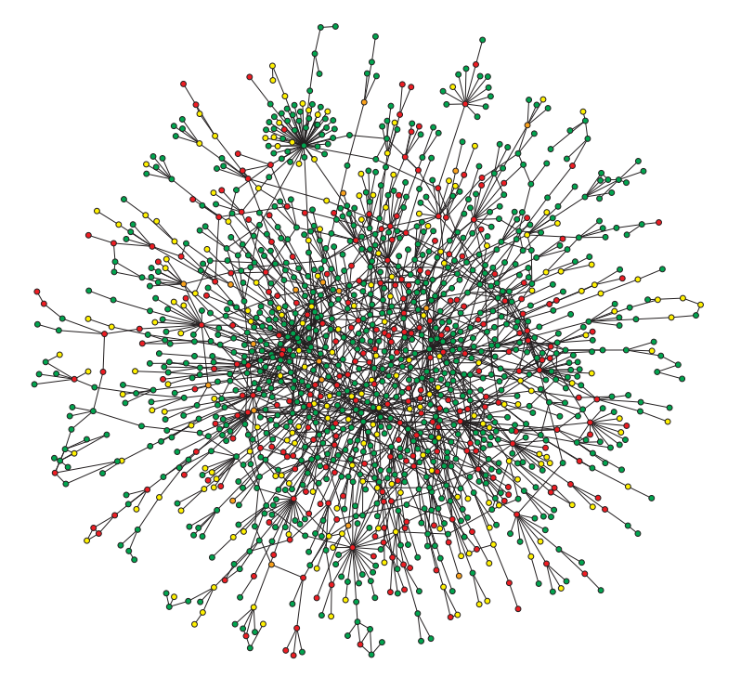
Approaches:
Statistical
Kinetical
Image from [1] the book by Krapivsky, Redner and Ben-Naim

Slide 4
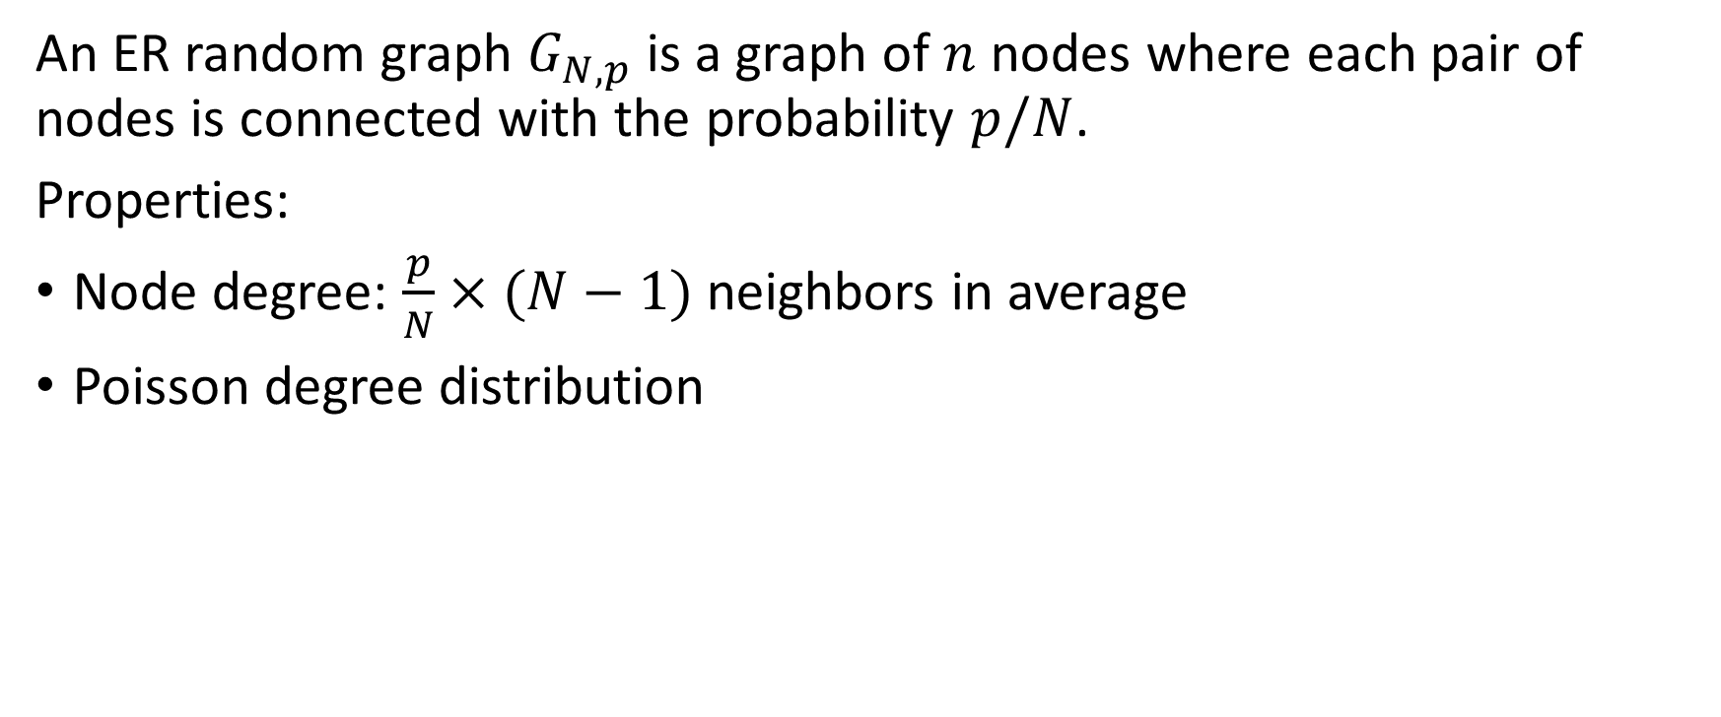
Random Graphs
An ER random graph $G_{N, p}$ is a graph of $n$ nodes where each pair of nodes is connected with the probability $p/N$.
Properties:
Node degree: $\frac{p}{N}×(N−1)$ neighbors in average
Poisson degree distribution

Slide 5

Kinetic approach
Step $0$ – $N$ isolated nodes

Slide 6

Kinetic approach
Step $i$ – connect 2 random nodes

Slide 7
Kinetic approach
Keep repeating

Slide 8

Equations
$n_{k}$ - proportion of the nodes with degree $k$
$\frac{dn_{k}}{dt}=n_{k−1}−n_{k}$
Initial condition: $n_{k}\left(0\right)=δ_{k,0}$
Solution: $n_{k}\left(t\right)=\frac{t^{k}}{k!}e^{−t}$ - Poisson distribution

Slide 9
Cycles

Slide 10

Same approach to calculate cycles
$s_{n}$ - probability of having exactly $n$ cycles
$\frac{ds_{n}}{dt}=\frac{1}{2\left(1−t\right)}(s_{n−1}−s_{n})$
Solution: $s_{n}\left(t\right)=\frac{{\left(1−t\right)}^{1/2}}{n!}{\left[\frac{1}{2}ln⁡(\frac{1}{1−t})\right]}^{n}$

Slide 11
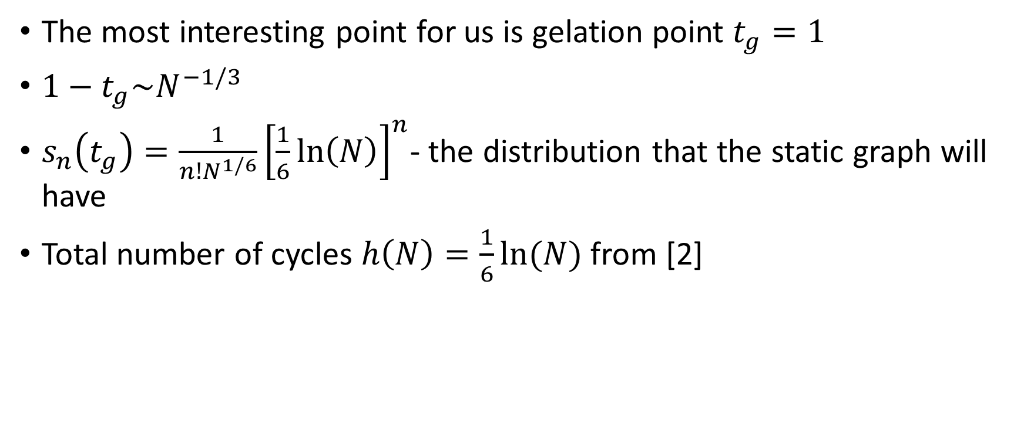
The most interesting point for us is gelation point $t_{g}=1$
$1−t_{g}\sim N^{−1/3}$
$s_{n}\left(t_{g}\right)=\frac{1}{n!N^{1/6}}{\left[\frac{1}{6}\ln\left(N\right)\right]}^{n}$- the distribution that the static graph will have
Total number of cycles $h\left(N\right)=\frac{1}{6}ln⁡(N)$ from [2]

Slide 12
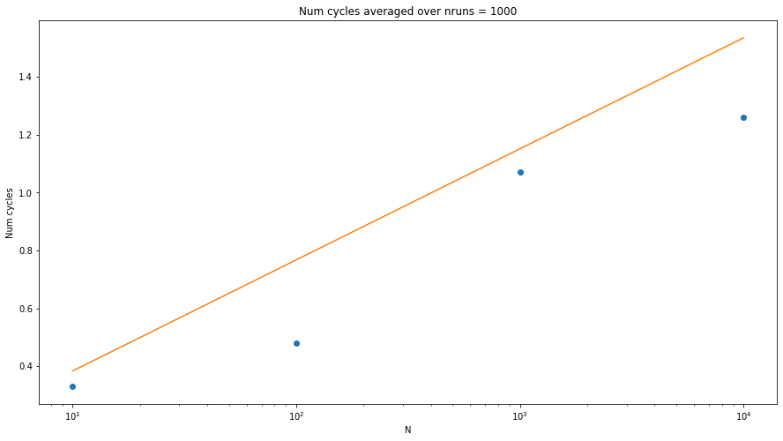

Slide 13
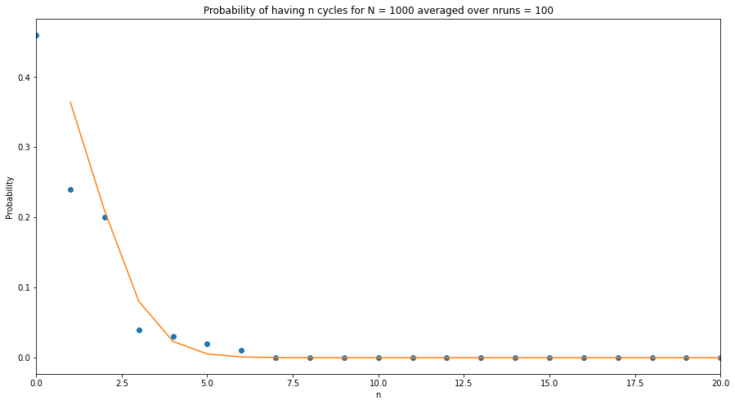

Slide 14
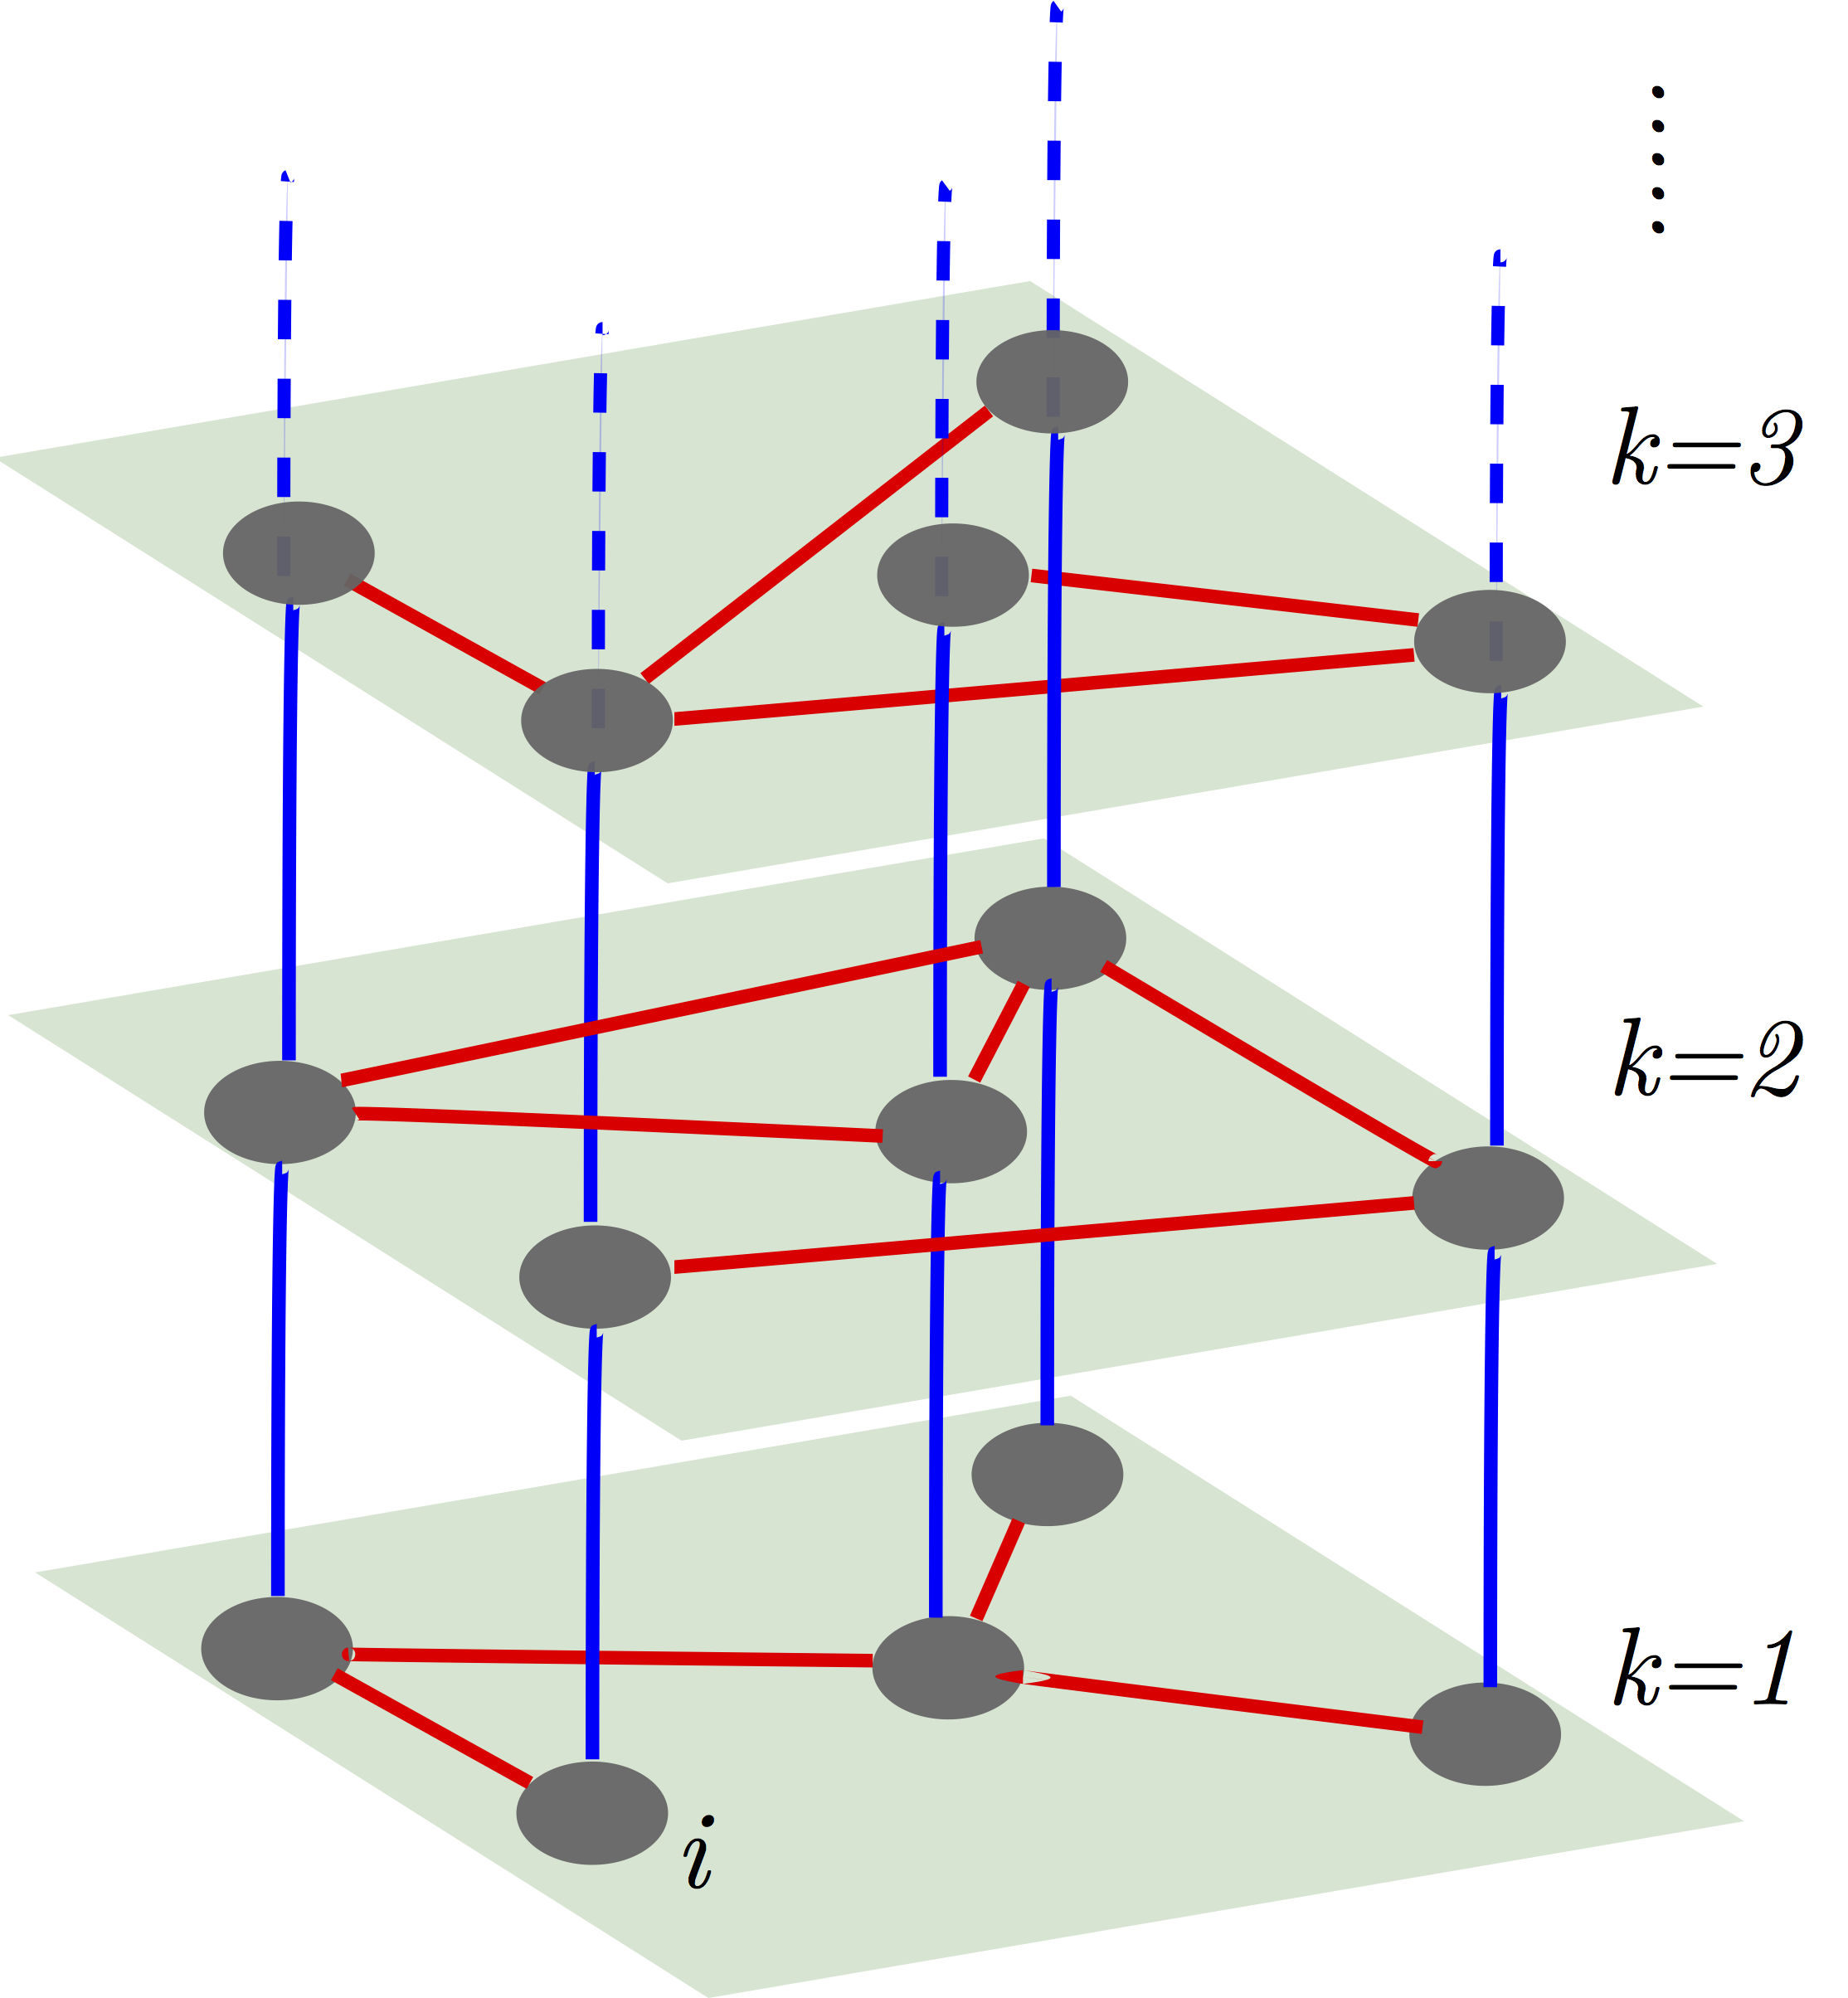
Multiplexity

Slide 15
Multiplexity

Slide 16
Multilayer cycles in a multiplex net can be mapped to a traditional network whose edges set is a union of the two sets of edges of each layer
View from above:

Slide 17
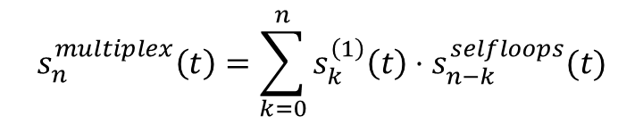
Selfloops are lost when projecting
View from above:
$$s_{n}^{multiplex}\left(t\right)=\sum_{k=0}^{n}{s_{k}^{\left(1\right)}\left(t\right)⋅s_{n−k}^{selfloops}(t)}$$

Slide 18
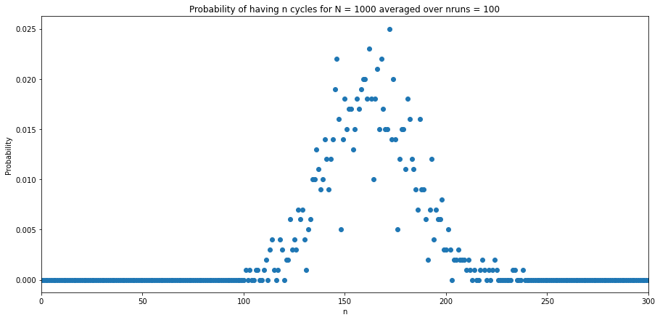
For multiplex networks

Slide 19
Future steps
Generalize the kinetics approach to the case of multiplex networks
Finalize the analytical derivations for cycles distribution in multiplex networks
Test them in numerical experiments

Slide 20
References
[1] Pavel L. Krapivsky, Sidney Redner, and Eli Ben-Naim A Kinetic View of Statistical Physics (2010).
[2] E. Ben-Naim and P.L. Krapivsky Phys. Rev. E 71, 026129 (2005).
[3] M. V. Smoluchowski, Phys. Z. 17, 557 (1916); Z. Phys. Chem., Stoechiom. Verwandtschaftsl. 92, 129 (1917).

